Slide 1

Clustering Algorithms
Jasamrit Rahala
JRahala

Slide 2
Agenda
Why use clustering algorithms?
When and where are they used?
Hierarchical Clustering
K Means Clustering
Gaussian Mixture Clustering

Slide 3
Clustering Algorithms
Clustering Algorithms help to split up data into k unique groups. Without any labels, therefore it is classified as unsupervised learning.
Hard clustering
Soft clustering

Slide 4
Applications
Pre-process data for supervised learning
Detect patterns (statistics)
Reduce data sizes and save time & space
Petal Length (cm) | Petal Width (cm) | # Petals | Stem Length (cm)
0.7 | 0.4 | 4 | 15
0.5 | 0.2 | 4 | 12
0.4 | 0.3 | 5 | 14
Cluster ID
2
1
3

Slide 5
Applications
Pre-process data for supervised learning
Detect patterns (statistics)
Reduce data sizes and save time & space
 | % Obese | Occupation | Geography
Blue group | 70 | IT | (0.85,0.60)
Red group | 20 | Teacher | (0.25,0.81)
Purple group | 15 | Plumber | (0.43,0.72)

Slide 6
Applications
Pre-process data for supervised learning
Detect patterns (statistics)
Reduce data sizes and save time & space

Slide 7
Notebook break
Read through the material and get a grasp on the data that we are dealing with as well as the end goal.

Slide 8
Hierarchical Clustering
Extremely simple greedy algorithm.
Finding local minimums in order to find the global minimum.
Find the two most similar data points, merge together.
Continue to merge until 1 group is formed
Distance metric Euclidean distance
Linkage Criteria Where do we measure from
Reproducible (returns the same result)

Slide 9
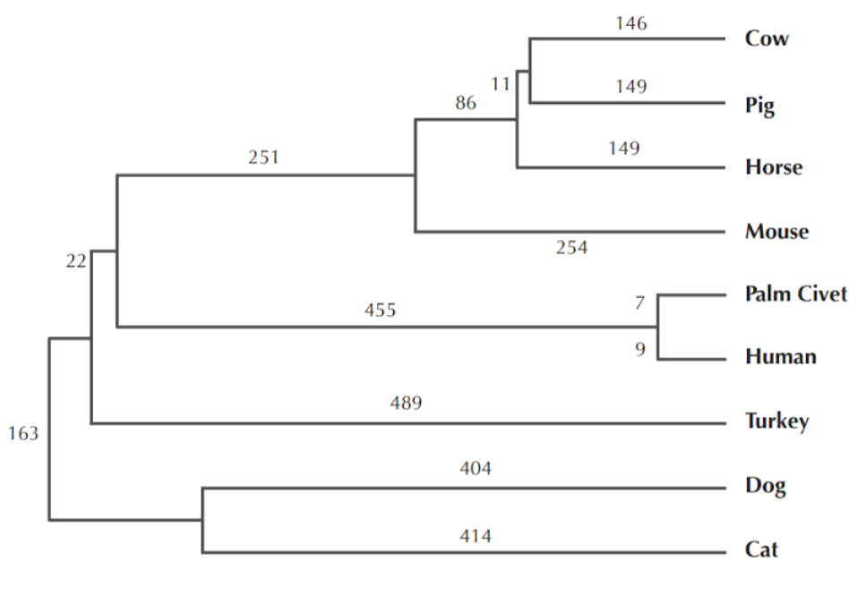
Hierarchical Clustering
Analytics, for example. The transferal of SARS from animals to humans.

Slide 10
Hierarchical Clustering
Compute the two closest groups using a distance metric.
Link these two groups and repeat.
1
2

Slide 11
Hierarchical Clustering
Compute the two closest groups using a distance metric.
Link these two groups and repeat.
1
2

Slide 12
Hierarchical Clustering
Compute the two closest groups using a distance metric.
Link these two groups and repeat.
1
2
1
2

Slide 13
Hierarchical Clustering
Compute the two closest groups using a distance metric.
Link these two groups and repeat.

Slide 14
Hierarchical Clustering
Compute the two closest groups using a distance metric.
Link these two groups and repeat.

Slide 15
Hierarchical Clustering
Compute the two closest groups using a distance metric.
Link these two groups and repeat.

Slide 16
Hierarchical Clustering
Linkage criteria.

Slide 17
Hierarchical Clustering
Linkage criteria.

Slide 18
Hierarchical Clustering
One giant group
5
10
6
1
2
1
2
12
11
11
8
9
11
3
8
4
12
7
9
7
10
3
4
5
6

Slide 19
Notebook break
Read through the material and get a grasp on the data that we are dealing with as well as the end goal.

Slide 20
K Means Clustering
Hard clustering. Iterative method, splits data into k clusters. K is predefined before hand.
Much faster than Hierarchical and is one of the most widely used algorithms.
Data must be comparable by Euclidean distance. Each cluster is radial and spans a certain radius in n – dimensions.

Slide 21
K Means Clustering
Define the number of groups, k
Randomly assign k centroids (the centres of groups)
Classify each data point as a member of a group
Repeat and update centroids positions until convergence
Measure the fit of the model to the data
Repeat with several models and choose the best one
That was a lot to take in, so let’s go through this step by step

Slide 22
K Means Clustering Define k groups
We will be using K Means on a mailing list dataset. By grouping the data we can find certain groups of consumers and potentially isolate behaviours, possibly for advertising.
Currently the optimum value of groups is unknown to me. I can graph the data to produce an estimate but later on we will talk about techniques to find k.

Slide 23
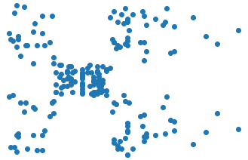
K Means Clustering Define k groups
Spending Score
Annual Income

Slide 24
K Means Clustering Assign Centroids
Centroids are the centres of our clusters. Given our clusters are circular, there is one unambiguous centre.
Initially these clusters will be randomly assigned in the data
Other ‘centres’ exist, like k-medians or k-medoids

Slide 25
K Means Clustering Classify data points
For each data point we calculate the distance to each centroid. The data point is classified as a member of the closest centroid.
distance metric = Euclidian
d = √(x – x’)² + (y – y’)²
d = √(x – x’)² + (y – y’)² +(z – z’)² …

Slide 26
K Means Clustering Update
After classifying each data point we can start to move the centroids. We take the mean average of each data point within each cluster and set the centroid of the group to this mean.

Slide 27
K Means Clustering Update
After classifying each data point we can start to move the centroids. We take the mean average of each data point within each cluster and set the centroid of the group to this mean.

Slide 28
K Means Clustering Update
After classifying each data point we can start to move the centroids. We take the mean average of each data point within each cluster and set the centroid of the group to this mean.

Slide 29
K Means Clustering Update
After classifying each data point we can start to move the centroids. We take the mean average of each data point within each cluster and set the centroid of the group to this mean.

Slide 30
K Means Clustering Update
After classifying each data point we can start to move the centroids. We take the mean average of each data point within each cluster and set the centroid of the group to this mean.

Slide 31
K Means Clustering Update
After classifying each data point we can start to move the centroids. We take the mean average of each data point within each cluster and set the centroid of the group to this mean.

Slide 32
K Means Clustering Update
After classifying each data point we can start to move the centroids. We take the mean average of each data point within each cluster and set the centroid of the group to this mean.

Slide 33
K Means Clustering Update
After classifying each data point we can start to move the centroids. We take the mean average of each data point within each cluster and set the centroid of the group to this mean.

Slide 34
K Means Clustering Update
After classifying each data point we can start to move the centroids. We take the mean average of each data point within each cluster and set the centroid of the group to this mean.

Slide 35
K Means Clustering Update
After classifying each data point we can start to move the centroids. We take the mean average of each data point within each cluster and set the centroid of the group to this mean.

Slide 36
K Means Clustering Update
After classifying each data point we can start to move the centroids. We take the mean average of each data point within each cluster and set the centroid of the group to this mean.

Slide 37
K Means Clustering Update
After classifying each data point we can start to move the centroids. We take the mean average of each data point within each cluster and set the centroid of the group to this mean.

Slide 38
K Means Clustering Update
After classifying each data point we can start to move the centroids. We take the mean average of each data point within each cluster and set the centroid of the group to this mean.

Slide 39
K Means Clustering Convergence
Notice how the cluster, centroids didn’t change during this iteration. We have reached a final state for this model.

Slide 40
K Means Clustering Convergence
Observe that based on our initial centroids we can come to different conclusion states. How do we know what states are the best? We need a metric for how well our model fits the data.

Slide 41
K Means Clustering Measure fit
We can measure the ‘fitness’ of a model, based on its variance. Variance is the summation of the Euclidean distances from the centre.
The lower the variance the better the fit.
15.3 + 21.4
15.3
36.7
21.4

Slide 42
K Means Clustering Repeat
By repeating the model and picking different initial centroids we can end up with different variance values.
We can use the model with the lowest variance.

Slide 43
K Means Clustering Optimum K
For certain datasets, the best K to use may not be clear.
Spending Score
Spending Score
Annual Income
Annual Income

Slide 44
K Means Clustering Optimum K
We can figure out the best clustering with the elbow method. If we continue to increase K, the model will have less variance but as some point will over fit. We can use the idea of diminishing returns and find the elbow in the graph below.
Variance
Values of K

Slide 45
Notebook break
Read through the material and get a grasp on the data that we are dealing with as well as the end goal.

Slide 46
Extension Gaussian distribution models
Soft clustering model, using Gaussians. Very similar to K Means

Slide 47
K Means Limitations
Due to the way K means equates distances and plots centroids, the clustering of K means is restricted in a radial fashion and doesn’t allow for soft clustering. Take a look at the graph below.

Slide 48

Gaussians
Gaussians are functions in mathematics that can be used to represent probability density.
Probability density functions
P(Height)
Height

Slide 49
Gaussians
What is the probability of someone being 1.7m tall?
1.7m
P(Height)
Height

Slide 50

Gaussians
What is the probability of someone being around 1.7m tall?
$$\int_{1.695}^{1.705}{P\left(x\right)dx}$$
1.7m +/- 0.05m
P(Height)
Height

Slide 51
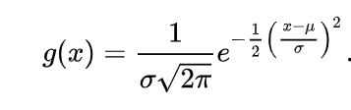
Gaussians
Gaussians are a type of probability density function, defined by the following equation
Understanding the derivation isn’t important. As long as you understand the application.

Slide 52
Gaussians
By using Gaussians as the distance function in K Means clustering, we can cluster intermingled data. This is effectively soft clustering. This is also known as mixture modelling.

Slide 53
Extension DBSCAN [Notebook]
This model is very primal in the sense that it uses a predefined distance and simply scans its neighbours until no more neighbours of the same group can be found. It is a very fast and intuitive algorithm.

Slide 54
Recap
The uses of clustering in the real world
Pre-processing for supervised learning
Pattern recognition
Data reduction
Hierarchical Clustering
K Means Clustering
Gaussian Mixture Modelling
DBSCAN

Slide 55
Thank you
Jasamrit Rahala
JRahala

